Slide 1

Customer Retention Analysis
For Indian E-Commerce Websites
Submitted by
Dheerajkumar Pittala

Slide 2
Contents
Introduction.
Business Problem Framing
Conceptual Background Of Domain Knowledge
Motivation for the Problem Undertaken
Analytical Problem Framing
Data Sources and their formats
Data Preprocessing Done
Hardware and Software Requirements and Tools Used
What is Customer Retention and its benefits.
Tools, Dataset and Assumption.
Exploratory Data Analysis.
The main factors that drive customer Retention.
Conclusion.
Limitations and Scope for future work.

Slide 3
Introduction
Through this slides we will be looking at the analysis made on the customer retention rate for Indian e-commerce companies.
We will be analysing the retention rate with the help of a survey answered by e-commerce customers on online retail companies and the factors that influence their purchase decision.
We will also be looking at the expectations of the customer on a good e-commerce website.

Slide 4
Problem Framing
Customer satisfaction has emerged as one of the most important factors that guarantee the success of online store; it has been posited as a key stimulant of purchase, repurchase intentions and customer loyalty.
A comprehensive review of the literature, theories and models have been carried out to propose the models for customer activation and customer retention.
Five major factors that contributed to the success of an e-commerce store have been identified as: service quality, system quality, information quality, trust and net benefit.
The research furthermore investigated the factors that influence the online customers repeat purchase intention.
The combination of both utilitarian value and hedonistic values are needed to affect the repeat purchase intention (loyalty) positively.

Slide 5
Conceptual Background Of Domain Knowledge
The data is collected from the Indian online shoppers. Results indicate the e-retail success factors, which are very much critical for customer satisfaction.
Five major factors that contributed to the success of an e-commerce store have been identified as: service quality, system quality, information quality, trust and net benefit. The research furthermore investigated the factors that influence the online customers repeat purchase intention.

Slide 6
Motivation Undertaken
The growth in technology is the most exciting part of growth. It has made our lives so much easy by decreasing the physical work .
Invention of smartphones and laptops have added a lot to relief the physical stress. Now using smartphones, we can do a lot of works like check weather updates, maps , video callings to out loved ones and in this we can also use it for online shopping's.
Nowadays people are more interested in online shopping as it is convenient to make some purchase while sitting home without going to market. As it saves time and also other costs like transportation, etc.
There are many websites/applications who are providing online shopping services. But as there is no direct contact between the seller and consumer it becomes somewhat difficult for the seller what customers want and what they should provide to their customers.
Considering the example like the payments options for purchasing the item, return options , order delivery options, which websites is providing better services.
So, I get motivated to analyze the data for finding the outcomes which will help customers and sellers for fulfill their wants.

Slide 7

Analytical Problem Framing

Slide 8
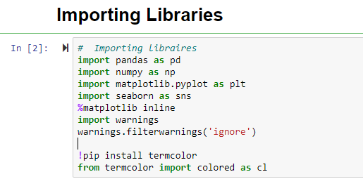
Data Sources
Our data source is FlipRobo Technologies, who provided the data in excel format during my internship program.
Before loading the dataset, we imported some libraries for loading and analyzing our dataset.

Slide 9
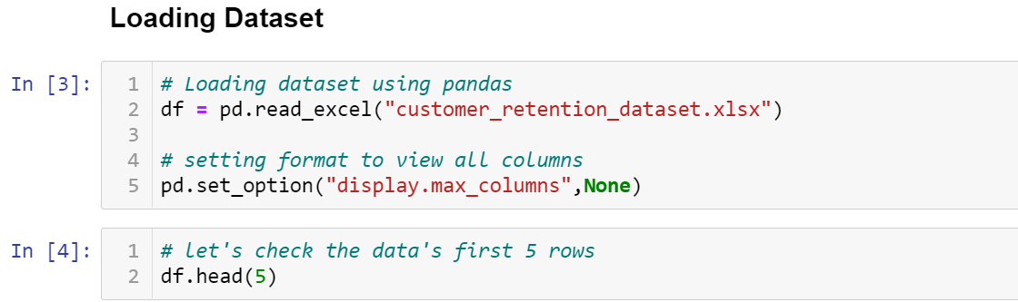
… cont
Now we are using Panda's library for loading our dataset which is in excel format.

Slide 10
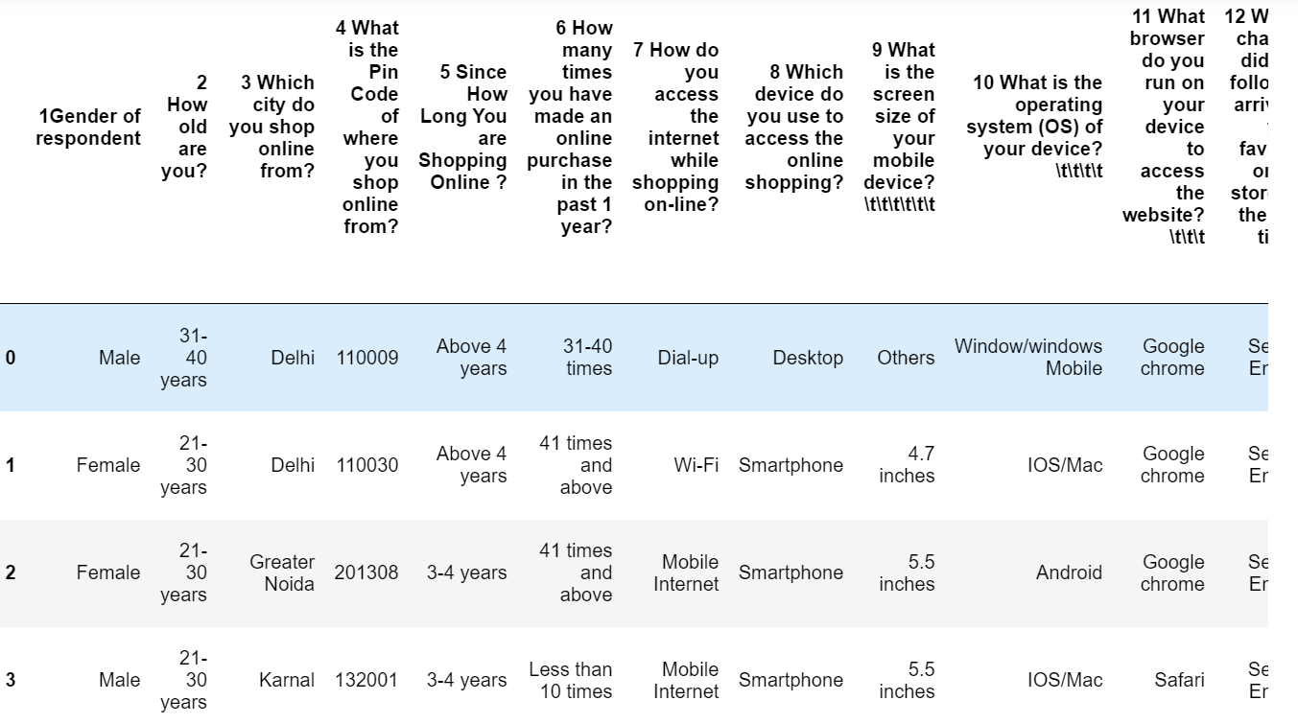
Let’s check our data

Slide 11
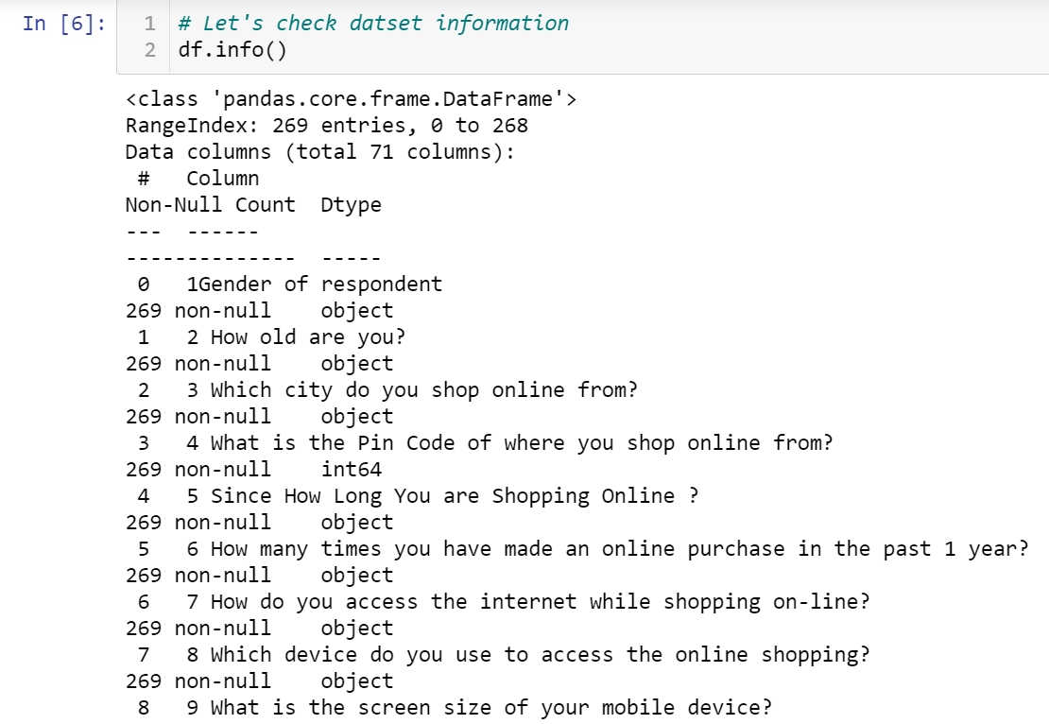
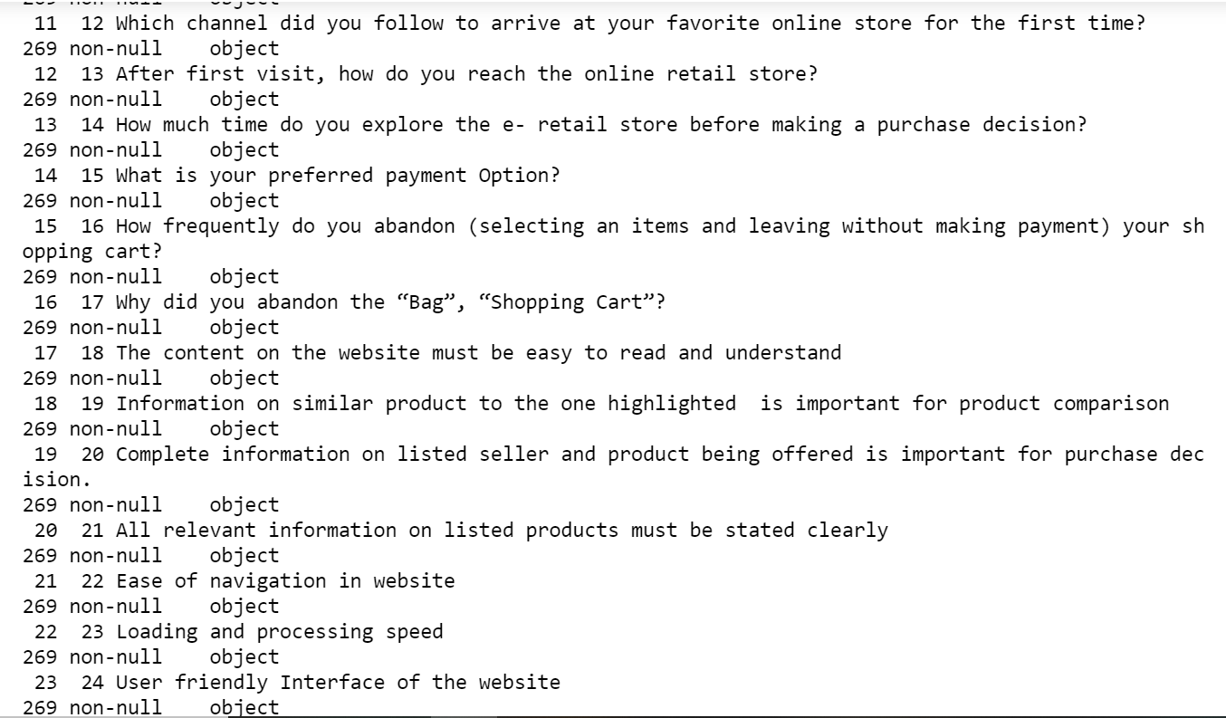
Data Formats

Slide 12
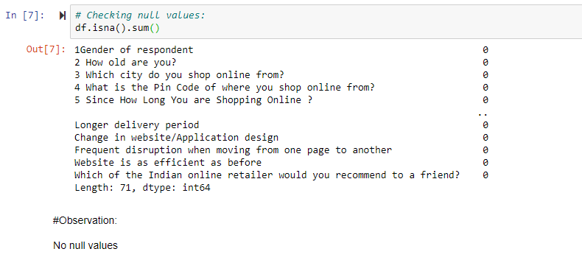
Data Pre-processing
Before going to further steps ,we do some data preprocessing . As it is necessary to clean our data before doing any analysis on it.
First, we will check the null values in dataset by using heatmap.
Checking null values

Slide 13
Software And Tool Requirements
There is no such requirement for hardware ,but I have used intel i5 8th generation processor
Software: Jupyter Notebook (Anaconda 3), Microsoft Word, Microsoft PowerPoint
Language: Python
Libraries used in project:
Pandas
Numpy
Matplotlib
Seaborn

Slide 14

What Is Customer Retention?
Customer retention means the process of maintaining or keeping customers once you have acquired them. It’s all the activities that a company must do in order to keep their customers around. The goal is to build a long-lasting relationship between the brand and consumers. Once a customer becomes loyal to your brand, not only he will buy more from you than a normal customer, but he’ll spread good words about your business, increase your reputation.

Slide 15

The Benefits Of Customer Retention:
Improve Conversion Rate.
Old Customers Buy More.
Reduce Marketing Cost.
Get More Feedback From Engaged Customers.
Word of Mouth – Referral Marketing.

Slide 16
Data And Assumptions
The gathered data contains 269 surveyors and 47 answers from each one of them
We have asked questions and recorded answers on 4 major categories.
The basic information of the population.
How was the online purchase made.
Important factors for making purchase decision and drives satisfaction.
Which e-commerce sites satisfies the above factors to make purchase decision and drives satisfaction.
The Assumption for this analysis is that, when we recommend something to a friend, it is most likely that we are using it, we will be using it in future, and we are satisfied with the service/experience we’ve received.

Slide 17
Exploratory Data Analysis

Slide 18
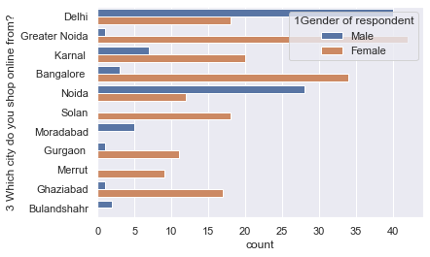
The Analysis is for the Indian e-commerce websites and the survey was randomly made from the buyers of different cities of India.

Slide 19
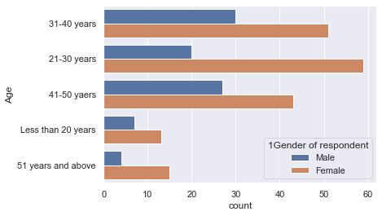
The population data consists of surveys from both male and female buyers from all age ranges, which is used to determine the factors that influence the customer retention rate.

Slide 20
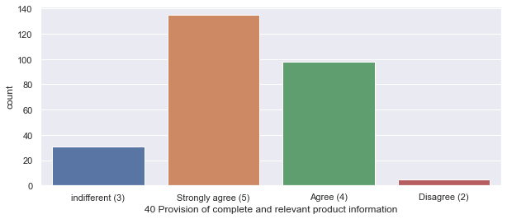
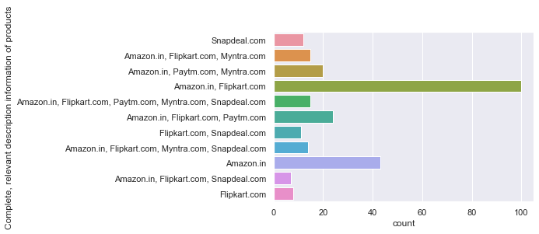
*Here, we are comparing the buyer’s expectation in any e-commerce website (Online Shopping Platform) with the actual companies which meet their expectations. *It is important for the companies to display all relevant information on listed products. *Most of the buyers believe Amazon and Flipkart provides this experience.

Slide 21
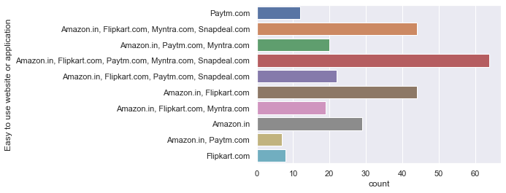
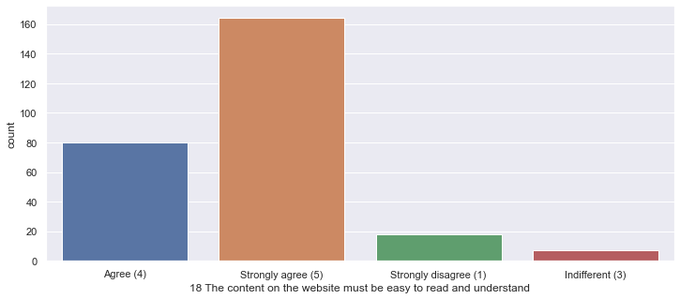
-Most of the buyers believe that the content on an e-commerce website must be easy to read and understand. -Here the expectations of the buyer is met by almost all the company, however the majority population mentioned Flipkart and Amazon.

Slide 22
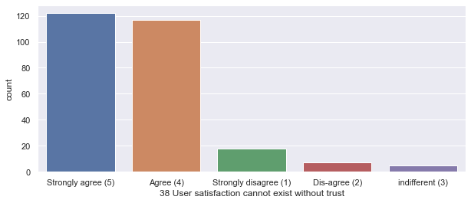
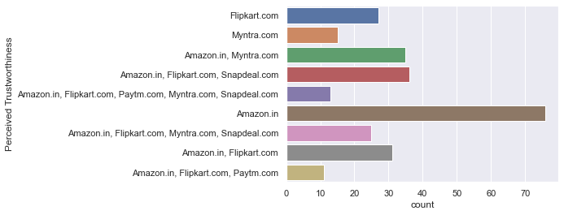
-Buyers believe that the user satisfaction cannot exist without trust in an e-commerce website. -Here we can clearly see from the above graphs, Amazon tops the list for the trust they have gained among the buyers

Slide 23
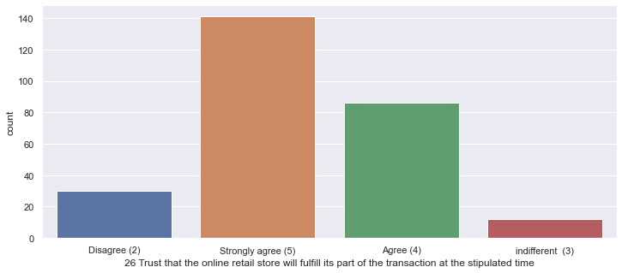
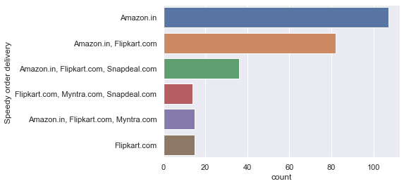
-Buyers trust that online retail store will fulfill its part of the transaction at the stipulated time, which is delivering products on time. -Buyers believe that Amazon and Flipkart deliver the order faster than other e-commerce website.

Slide 24
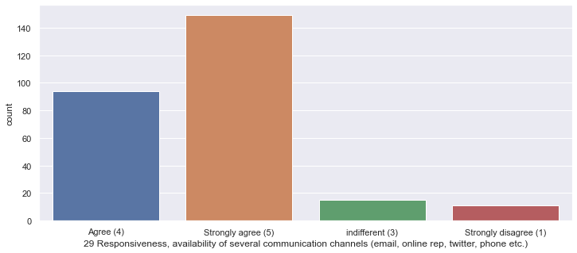
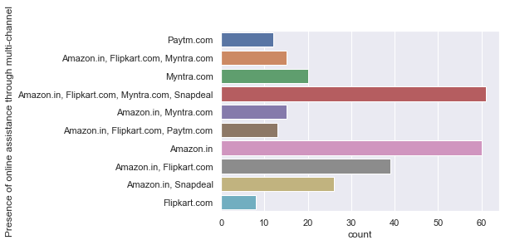
-Buyers prefer to have availability of online assistance through multiple channels in order to buy with confidence. -When it comes to availability of online assistance to multiple channels, Flipkart and Amazon tops the list.

Slide 25
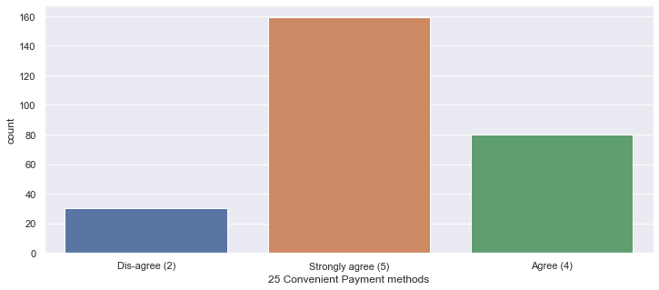
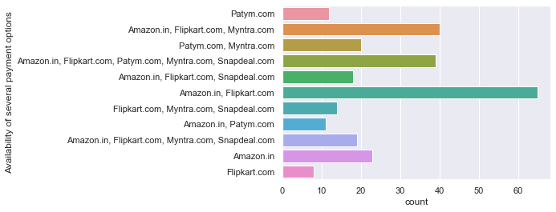
-Availability of more options in communication channels for customer support is very important and most of the buyers agree to it because Customer service is the support you offer your customers — both before and after they buy and use your products or services — that helps them have an easy and enjoyable experience with you. Offering amazing customer service is important if you want to retain customers and grow your business. -Offering multiple payment options can scale-up your conversion by a significant margin and improve customer satisfaction. The more options you provide, the more comfortable users will feel during checkout. When you accept more customers' preferred payment method you will make more sales. We live in a culture of convenience where people don't have the patience for inefficiencies, no matter how small they may seem. A customer will be more likely to shop at your websites if they have more options. Here when it comes to Availability of several payment options, Flipkart.com and Amazon.in is having the highest no of payment options.

Slide 26
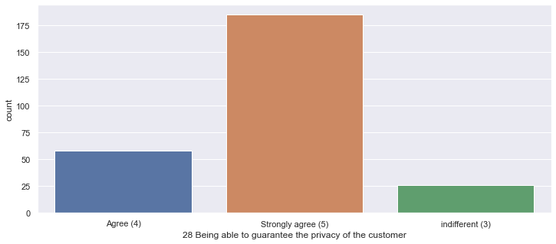
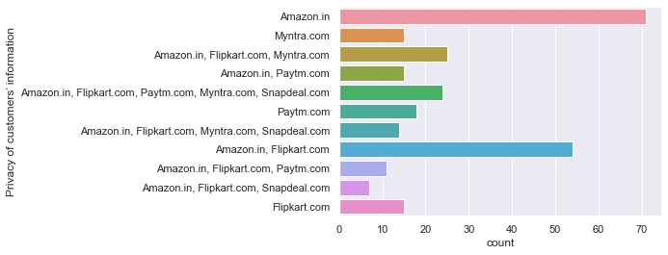
-Most important part according to the buyer is that an e-commerce website should be able to provide complete privacy to its buyers in-order to shop with confidence. -We can clearly see that most of the buyers agree that Amazon and Flipkart are able to provide complete privacy to its buyers.

Slide 27
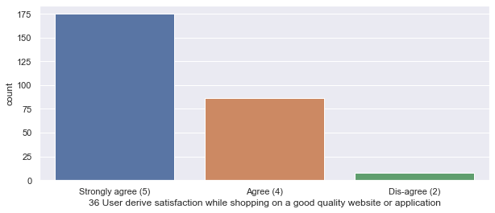
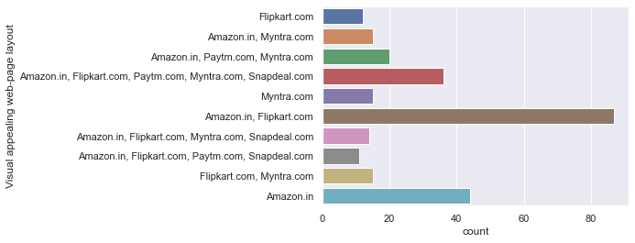
-Buyers believe that a visually appealing website is necessary, and it gives a sense of satisfaction when the quality of website is good. -Even when it comes to visually appealing and good quality website, most of the buyers voted for Amazon and Flipkart.

Slide 28
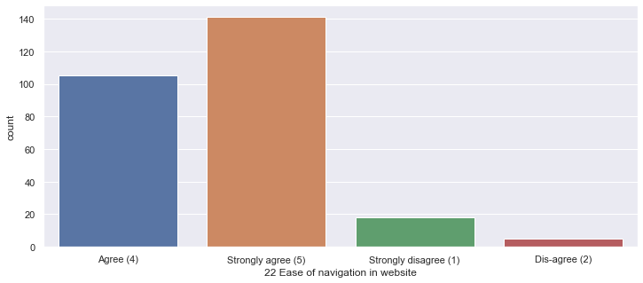
-Buyers believe that ease of navigation is important in a e-commerce website. -Most of the people voted for Amazon.in, Flipkart.com, Paytm.com, Myntra.com and Snapdeal.com that their websites are easy to use.

Slide 29
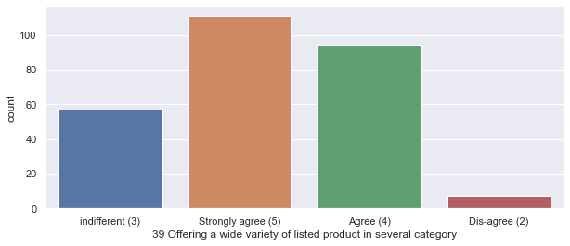
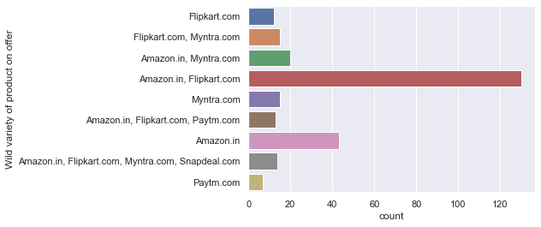
-Buyers agree that a good e-commerce website should offer a wide variety of products over the categories. -As per the answers from the buyers, Amazon and Flipkart are topping the list for offering wide variety of products.

Slide 30
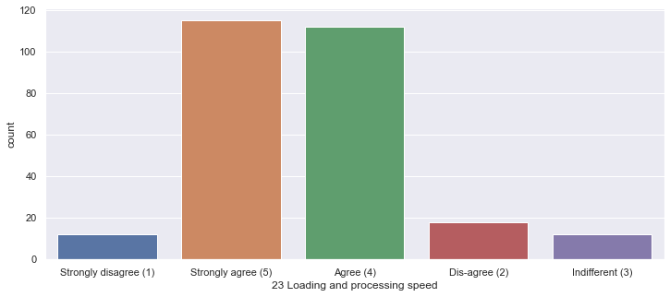
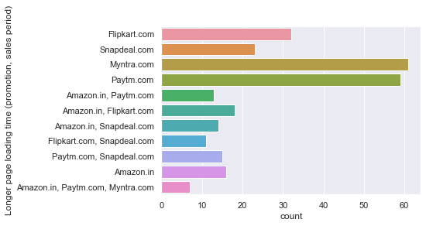
The E-commerce Sites –Drawbacks Buyers agree that the e-commerce sites should offer good processing speed for a better buyer experience, which makes customers to buy from them again. However, the highest number of buyers voted that the sites like Myntra and Paytm fail to offer the same.

Slide 31
-Buyers believed that having convenient payment methods are necessary in an e-commerce website. As we can see most of the buyers voted that Snapdeal and Amazon provided limited payment modes.

Slide 32
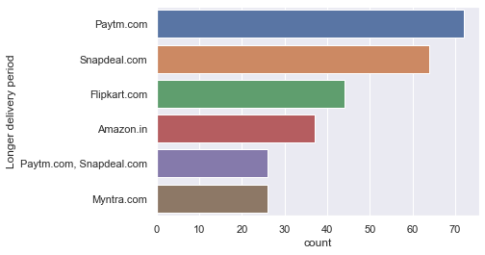
-From the below analysis, we can say that the comparisons between companies that offered quicker delivery of the products and the companies that had longer delivery periods according to the buyers, who believed that receiving the products on time/faster was required to make a purchase decision. Here Paytm and Snapdeal has longer delivery periods.

Slide 33
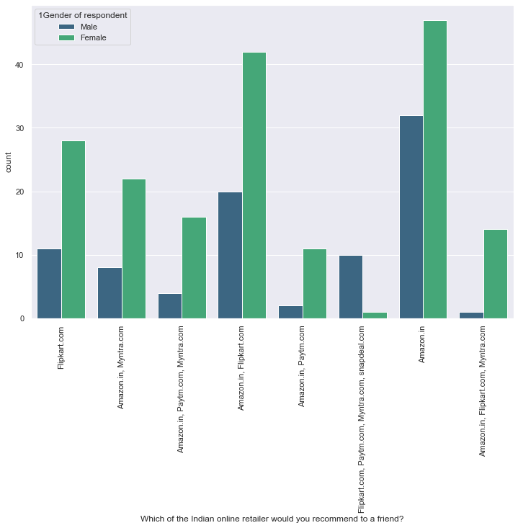
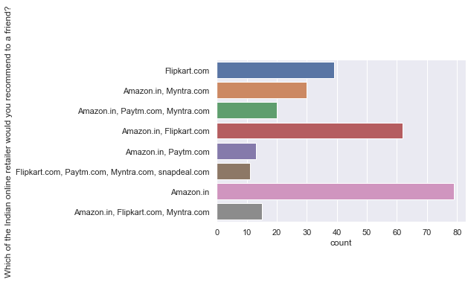
From the analysis till now, I can say that the companies with highest retention and customer satisfaction rates are Amazon.in and Flipkart.com because their positives are line with the buyer preferences, and they are most likely to use this websites for purchases in future. Hence Amazon.in is the highest referable website to their friends and relatives.

Slide 34
Thoughts
-Initially we assumed that customers recommend e-commerce websites to their friends, if they are satisfied with the service and they are frequently using the websites for online shopping. -In order to prove that the customer expectations on an e-commerce website should influence the websites they recommend to their friends. -This implies that the websites recommended to their friends should meet the customer expectation and it is highly likely to be re-visited by the buyers for future purchases. -This hypothesis proves that the buyer who recommends a e-commerce site to a friend is the retained buyer of the respective e-commerce companies.

Slide 35
The Main Factors That Drives Customer Retention Are:
Easy to read and understandable content.
Relevant information on all the products.
Easier website design and navigation.
User friendly Interface.
Convenience in payment methods
Trust and On time delivery.
Better Customer Service.
Secure and offers complete privacy to their customers.
Discounts and Monetary Benefits.
Wide range of options and product selections.
Flexibility in their offers and services.
Return and Replacement policies.
Quality information on websites.
Website Quality.
Value for the money spent.

Slide 36
Conclusion
To conclude, having the right customer retention strategy will keep your company grows if you know how to take advantage of it. Your customers will find their way back and continue buying stuff from you. At the end of the day, what you need to do is fulfilling your customers’ needs, listen to their complaints and provide professional solutions. If your customers feel like they are valued, they will become increasingly loyal to your brand. Customer satisfaction is important to win the customer back. There is lot of competition in e-commerce space of retailers hence company should focus in offering the best service.
From the above analysis, I can say that the companies with highest retention and customer satisfaction rates are Amazon.in and Flipkart.com because their positives are line with the buyer preferences, and they are most likely to use this websites for purchases in future.
Most user will recommend Amazon.in and Flipkart to their friends.
snapdeal.com is far behind as only 4.1% of the user will recommend it to their friends.
The company with moderate retention rate is Myntra.com.
Further, the company with very low retention rate and customer satisfaction is with Paytm and Snapdeal because most of the factors are not in line with the customer preferences and they are less likely to use this website again for online purchases or they will hardly refer to their friends.

Slide 37
Customer satisfaction plays a major role in retention, A company should first understand what customers expects while purchasing online (e-commerce) and build a better buying experience which will in turn retain the customer. An unforgettable experience is what drives customers to buy again and again.
The interface should be user friendly. There should be complete description of the product on the website or application, and it should be efficient to use.
Company should win customer trust that their personal and financial details are secure with us and will not be used for any fraudulent activity.
One of the best way to retain the customer is to have a rewarding loyalty program. Customer should feel invested in the company, and they will be happy that every purchase they are making will lead to more rewarding experience.
Any issue while browsing should be addressed. Customer may lose out on the deal if there is some glitches or technical issue with the website. The browsing should be quick especially during the sale or promotion period.

Slide 38
Amazon - The most recommended websites with attractive web-page layout, easy to use, relevant descriptive information, product offers, reliability of website, quickness to complete purchase, trust worthiness.
Improvements: Takes longer time to login, Late declaration or price during sales and promotion, frequent disruption when moving from one page to another, Limited mode of payment on most of products.
Flipkart: This is the 2nd most recommended website with fast loading page, security of financial information, trust worthiness, several payments modes, website is as efficient as before.
Improvements: Takes longer time in displaying graphics, late declaration of price during sales and promotion. privacy information, reliability of website, offers on product, and must be an attractive web-page layout.

Slide 39
Myntra: Myntra stands on 3rd most recommended websites with easy to use, wild variety of product offers, several payment methods, attractive visual appealing web-page layout.
Improvements: Relevant information about product, website loading speed, speedy delivery of products, websites is not much efficient as before.
Paytm: Reliability of website, speedy delivery of products, quickness in purchase.
Improvements: Longer page loading time, Longer delivery period , late declaration of price during sales and promotion.
Snapdeal: Least recommended website having less page loading time.
Improvements: Limited mode of payments, frequent disruption while moving from one page to another, Longer delivery period, customer’s

Slide 40
Limitations Of This Work And Scope For Future Work:
There is one major limitation to the analysis, due to the minimum data there are 50% more female surveyors when compared to male and this margin is huge.
Further the data is very less to come to a sure conclusion on the retention rate. And if we are analyzing the retention, it would be fair to ask the surveyors the direct question on which websites are they are likely to buy from the websites in future.

Slide 41

If any E-commerce sites/application have a great deepen through the above-mentioned points, the company will retain customers and it will help to grow the business because there will be lot of referrals awaiting.

Slide 42

Thank you

